Slide 1
Welcome to
Class 6
Teacher: Mrs Bridle
Teaching Assistant: Mrs Phipps

Slide 2




Year 6 Topics
Autumn: World War Two
Spring: Charles Darwin & the Voyage of HMS Beagle
Summer: The Ancient Maya & The Rainforests

Slide 3
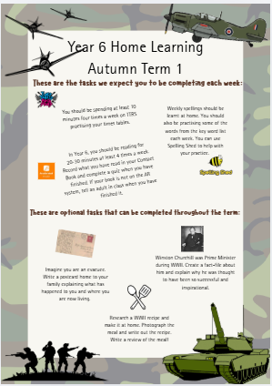
Home Learning

Slide 4
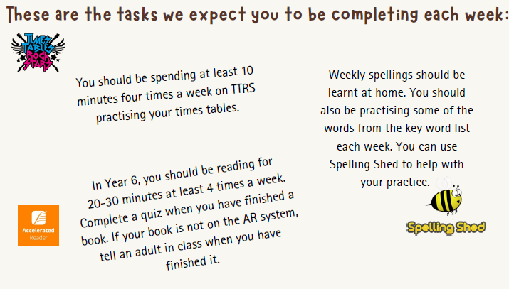

Slide 5
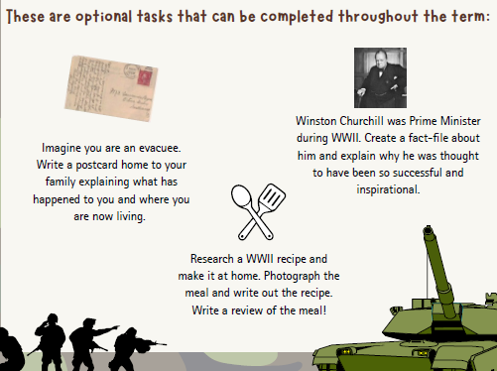

Slide 6
A new approach to home learning
At our Meet the Teacher sessions next week, teachers will share the home learning expectations for each class, including the type and frequency of activities that children will be expected to complete at home.
Over the coming weeks, we will also be launching a new digital app for home learning and class communication. This will give parents and children a simple way to:
see homework that has been set and keep track of what has been completed;
record homework completion quickly from a phone or other device;
submit photographs of completed pieces of homework;
communicate with teachers about class-related matters.
The new system will eventually replace the three paper books currently used for reading records, home-school communication and homework journals.
We are making this change for two main reasons. Firstly, we want to make life easier for families. Recording that homework has been completed should be as simple as a quick click on your phone, rather than having to find the reading record or homework book – and, of course, a pen that actually works!
Secondly, the digital system will make it much easier for staff to identify patterns in homework completion. This will help us to provide additional opportunities in school, such as a lunchtime homework club, for children who may find it difficult to complete home learning at home.

Slide 7
Until the new system is launched
There will be a short transition period while we get everything ready. In the meantime:
Class-related messages: please continue to use your child's class email address. These accounts will be checked once each day, and teachers will respond within one working day of receiving a message.
Learning Log tasks: these can be submitted to the class email address until the new app is ready.
Reading: please continue to encourage your child to read regularly at home. We will not be monitoring the recording of reading in reading records during this transition period. Simply focus on enjoying reading together until the new digital system is up and running.
We hope the new system will make home learning simpler for families, easier for teachers to manage and, most importantly, help us to provide better support for children who need it. We will provide further information about the app, including how to access and use it, before it goes live.

Slide 8
Spellings
New spellings will be sent home for the whole term, labelled with the date at the top to show when each set will be tested. Our spelling tests this term will be on a Thursday.
Along with the weekly spellings, we are also looking to help children improve in their spelling of key words. ​
At the beginning of each term, we will test them on the Year 5 and 6 statutory spelling list. ​
We would then ask that children learn some of the words they don’t know, alongside their weekly spellings. We will also practise these in school.

Slide 9
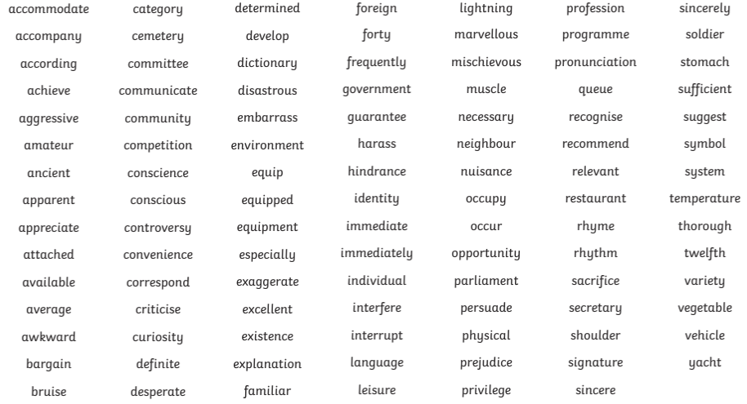
Year 5 & 6 Statutory Spellings

Slide 10
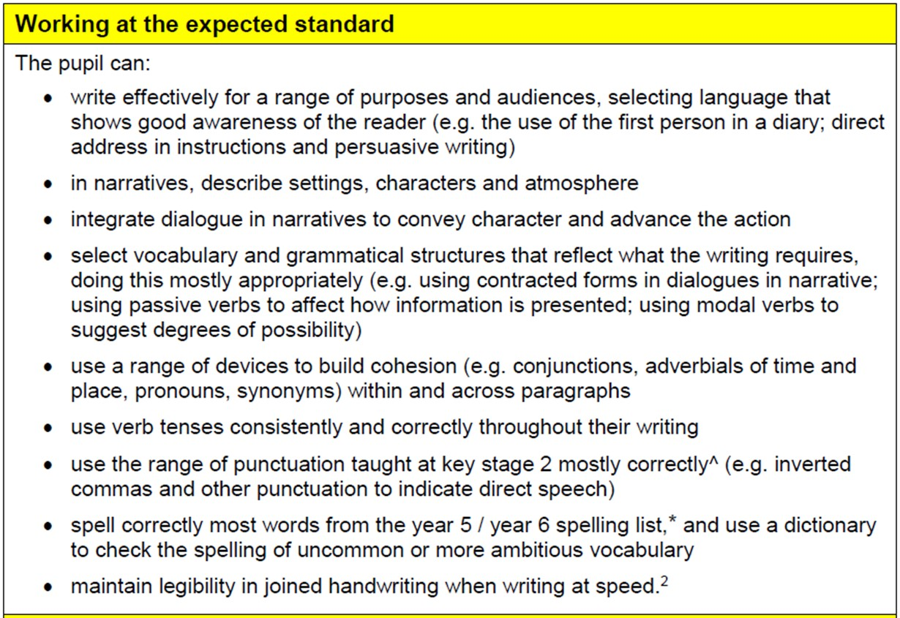
Writing Expectations

Slide 11
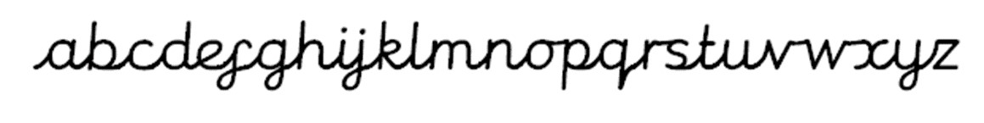
Statutory Assessment
Writing
•Handwriting must be joined and clear for children to reach the expected standard for the end of Year 6.

Slide 12
Maths
Number - number and place value
read, write, order and compare numbers up to 10,000,000 and determine the value of each digit
round any whole number to a required degree of accuracy
use negative numbers in context, and calculate intervals across 0
solve number and practical problems that involve all of the above
Number - addition, subtraction, multiplication and division
multiply numbers up to 4 digits by a two-digit whole number using the formal written method of long multiplication
divide numbers up to 4 digits by a two-digit whole number using the formal written method of long division
perform mental calculations, including with mixed operations and large numbers

Slide 13
Number - Fractions (including decimals and percentages)
add and subtract fractions with different denominators and mixed numbers
multiply simple pairs of fractions, writing the answer in its simplest form for example, 1/4 × 1/2 = 1/8
divide fractions by whole numbers [for example, 1/3 ÷ 2 = 1/6 ]
associate a fraction with division and calculate decimal fraction equivalents [for example, 0.375] for a simple fraction [for example, 3/8 ]
identify the value of each digit in numbers given to 3 decimal places and multiply and divide numbers by 10, 100 and 1,000 giving answers up to 3 decimal places
Ratio and proportion
solve problems involving the relative sizes of 2 quantities where missing values can be found by using multiplication and division facts
solve problems involving the calculation of percentages [for example, of measures and such as 15% of 360]
Algebra
use simple formulae
generate and describe linear number sequences
express missing number problems algebraically
find pairs of numbers that satisfy an equation with 2 unknowns

Slide 14
Measurement
solve problems involving the calculation and conversion of units of measure
use, read, write and convert between standard units
recognise when it is possible to use formulae for area and volume of shapes
calculate the area of parallelograms and triangles
Geometry - properties of shapes
draw 2-D shapes using given dimensions and angles
recognise, describe and build simple 3-D shapes, including making nets
compare and classify geometric shapes
illustrate and name parts of circles
recognise angles where they meet at a point, are on a straight line, or are vertically opposite, and find missing angles
Geometry - position and direction
describe positions on the full coordinate grid (all 4 quadrants)
draw and translate simple shapes on the coordinate plane, and reflect them in the axes
Statistics
interpret and construct pie charts and line graphs and use these to solve problems
calculate and interpret the mean as an average

Slide 15
P.E.
P.E. will be on Friday with Mrs Verge and on Wednesday afternoon we will have swimming at White Oaks.
Please ensure all P.E. kit is in school and named.​
If your child has earrings, they can either be removed or taped.​
As the weather gets colder, please make sure children have a tracksuit as some sessions may be outside.​

Slide 16
SATs
SATs will be the week beginning Monday 10th May 2027
There are tests in:
• Reading
• Spelling, Punctuation and Grammar
• Maths
There will be more information about the KS2 SATs nearer the time.

Slide 17
General Information
Year 6s exit the building at the end of the day through the classroom fire door.
​
If you are happy for your child to walk home from school or to meet you, please make sure you have given permission. Please let us know if this changes, particularly when clubs start.​
If children bring a phone into school, it will be placed in the box which is in my desk. It is kept in a locked drawer until the end of the day.

Slide 18
Any questions?
yearsix@high-firs.kent.sch.uk

