Slide 1
Welcome to Year 1
Mrs Everest
Mrs Spokes Miss Hoskins

Slide 2
Introduction
Starting Year 1 can be a little bit daunting for the children, so we are aiming to make the transition as smooth as possible!
In Year 1, the children will be learning so much, and it will be a mixture of child-led and adult-led activities.
Year 1 children follow Key Stage 1 (KS1) of the National Curriculum. This stage marks a move from pay based learning to more structured lessons.
Core Subjects: English, Maths, Science
Foundation Subjects: Art and Design, Computing, Design and Technology, Geography, History, Music and Physical Education.
Other Required Studies: Religious Studies, Personal, Health and Economic (PSHE).

Slide 3
Challenge Time
We will be doing Challenge Time twice a week for the first 2 terms, and this will reduce as we go through the year to allow the children to begin transitioning into Year 2.
Their work from Challenge Time will be put into your child's folder, as they will be completing Challenges throughout Challenge Time
Challenge focus will be based upon learning already taught within whole class teaching.

Slide 4

Reading
Reading will be the same as Reception
On Monday, we will start a new book in school, and it will be sent home on a Wednesday
This book should be returned on the following Monday
The children will also get a sharing book to bring home and share with you!
After half term we will introduce a Reading Mountain – if the children read 4 times a week, they will move up the Reading Mountain! Once they reach the peak, house points will reward the children's effort.
We will also be choosing a Reader of the Week to celebrate their amazing reading both within school and at home.

Slide 5

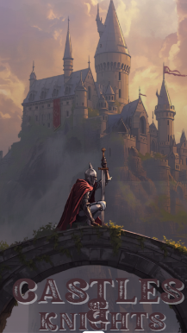



Topics
Our Wonderful World
Castles and Knights
African Adventure
African Adventure
Down at the Bottom of the Garden
Great Fire of London

Slide 6

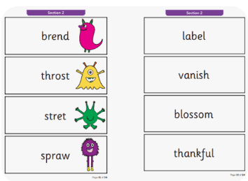
Phonics Screening
The Phonics Screening Check takes place in Year 1, usually in June. The test contains 40 words. Some of these words are real words and some are ‘non-words’ or ‘nonsense words’. Children will be prepared for the fact that some of the words will not be real words, and these words are identifiable during the test by having a small image of an alien next to them. These ‘non-words’ are important because all children will need to use their decoding skills to read them as they will have not been learnt by sight. Each child will sit one-to-one with an adult and will be asked to read the 40 words out loud.

Slide 7
General Information
PE Day is Monday
Bikes Friday
Contacting staff-Home learning, recording reading.
We are currently transitioning to a new digital app for home learning and class communication; to replace contact books(blue books) and reading records (yellow books) so any messages, home learning task please submit to the class email: yearone@high-firs.kent.sch.uk for the time being. Reading will not be monitored currently however reading expectations remains 4 reads at home
Emails will be checked once a day and will be responded to within 24hours.If there is an urgent message please inform the school office.
Further information will be provided about the app, including how to access and use it , before it goes live.

Slide 8
Questions or any worries…
Our door is always open, please come and talk to us if you have any questions, worries or concerns.
All the staff are looking forward to the year ahead with your children.

