Slide 1
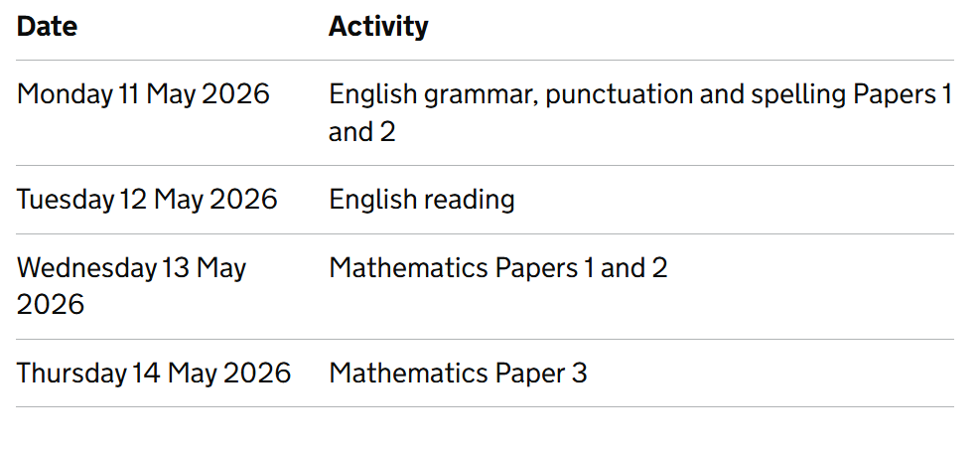
Year 6 SATs 2026

Slide 2
Specific arrangements for SATs
Majority of the children will take the SATs in the Year 6 classroom.
Some children will have different arrangements,
such as having extra time, a reader or a scribe;
these children will take the tests in separate rooms
with different adults.
The key stage 2 tests will be taken on set dates unless your child is absent, in which case they may be able to take them up to 5 school days afterwards.

Slide 3
Specific arrangements for SATs
Children with additional needs, who have similar provision in their day-to-day learning at school, may be allocated specific arrangements, including:
• Additional (extra) time;
• Tests being opened early to be modified;
• An adult to read for them;
• An adult to scribe (write) for them;
• Written or spoken translations of the mathematics reasoning papers;
• The use of prompts or rest breaks.
If your child needs different arrangements, myself or Miss Rennie will speak to you about this in due course.

Slide 4
After taking the SATs, children receive a raw and a scaled score. Their raw score is the actual number of marks they get and this will be translated into a scaled score.
This helps to allow for differences in the difficulty of the tests from year to year so that pupils' results can be compared accurately.
In KS2, the test papers are marked externally, with no teacher assessment involved.

Slide 5
The range of scaled scores available for each KS2 test ranges from 80, the lowest possible scaled score, to 120, the highest possible scaled score.
A scaled score of 100 or more means that the child has met the expected standard in each KS2 SATs test; a scaled score of 99 or less means they haven't reached the government-expected standard.
When the results are released, you will receive the scaled scores and a confirmation of whether or not the national standard has been achieved. Results will be given as either ‘expected standard met’ or ‘has not met’.

Slide 6
Grammar, Punctuation and Spelling: Monday 11th May
Grammar, punctuation and spelling consists of two papers.
Paper 1 focuses on all three elements (grammar, punctuation and spelling or GPS). The paper lasts for 45 minutes.
Paper 2 consists of a spelling test only. It should take approximately 15 minutes, although this is not a set amount of time.

Slide 7
Grammar, Punctuation and Spelling: Paper 1 (GPS)
This test focuses on:
Grammatical terms/ word classes;
Functions of sentences;
Combining words, phrases and clauses;
Verb forms, tenses and consistency;
Punctuation;
Vocabulary;
Standard English and formality.
This test requires a range of answer types but does not require longer formal answers.

Slide 8



Grammar, Punctuation and Spelling: Paper 1 (GPS)
Example questions:
✔
The council maintain the local park.

Slide 9


Grammar, Punctuation and Spelling: Paper 2 (spelling)
Paper 2 is a shorter paper that focuses solely on spellings.
Example questions:

Slide 10
Reading: Tuesday 12th May
There is one reading test that lasts for 60 minutes.
The test is designed to measure if the children’s comprehension of age-appropriate reading material meets the national standard. There are three different set texts for children to read. These could be any combination of non-fiction, fiction and/ or poetry.
The test covers the following areas (known as Content Domains):
Give/ explain the meaning of words in context;
Retrieve and record information/ identify key details from fiction and non-fiction;
Summarise main ideas from more than one paragraph;
Make inferences from the text/ explain and justify inferences with evidence from the text;
Predict what might happen from details stated and implied;
Identify/ explain how information/ narrative content is related and contributes to meaning as a whole;
Identify/ explain how meaning is enhanced through choice of words and phrases;
Make comparisons within the text.

Slide 11



Reading
The reading SATs paper requires a range of answer styles.
Example questions:

Slide 12




Reading
Example questions:

Slide 13



Reading
Example questions:
3 mark question

Slide 14
Reading
Since the current testing formation for the SATs began in 2016, there has been a tendency for three types of questions to be the most popular.
In the 2025 Reading SATs paper,
12% of marks could be gained from answering questions involving giving and explaining the meaning of words in context;
30% of marks could be gained from answering questions involving retrieving and recording information or identifying key details from a text;
48% of marks could be gained from answering questions involving making inferences from a text and justifying inferences with text evidence.
When reading with your child at home try focusing on these types of questions.

Slide 15
Maths: Wednesday 13th May and Thursday 14th May
The maths assessments consist of three tests.
Paper 1: Arithmetic (30 minutes) – Wednesday 13th May
Paper 2: Reasoning (40 minutes) – Wednesday 13th May
Paper 3: Reasoning (40 minutes) – Thursday 14th May

Slide 16


Maths Paper 1 (Arithmetic)
The maths arithmetic paper has a total of 40 marks and lasts for 30 minutes.
The test covers the four operations (addition, subtraction, multiplication, division, including order of operations requiring BIDMAS), percentages of amounts and calculating with decimals and fractions.
Example questions:

Slide 17

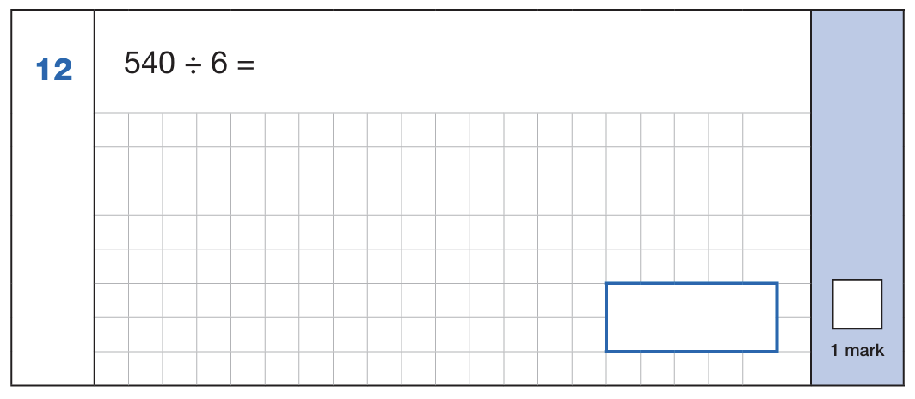

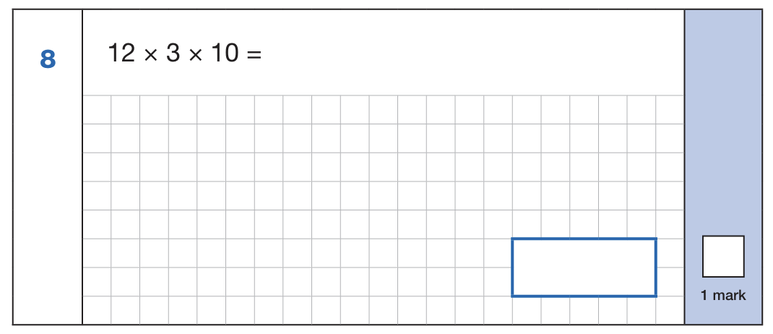
Maths Paper 1 (Arithmetic)
Example 1 mark questions:
Using known fact of 10% of 860 = 86
And 5% is half of 10%
86 ÷ 2 = 43
43
Known facts: 54 ÷ 6 = 9
90
Mental method:
Using known fact of 64 ÷ 8 = 8
80
⅝ x ⅓
5 x 1 = 5
8 x 3 = 24
⅝ x ⅓ = 5/24
5/24
12 x 3 = 39
39 x 10 = 390
390

Slide 18


Maths Paper 1 (Arithmetic)
Example 2 mark question:

Slide 19
Maths Papers 2 and 3 (Reasoning)
Paper 2 will take place on Wednesday 13th May and paper 3 will take place on Thursday 14th May. These tests have a total of 35 marks each and lasts for 40 minutes each.
These papers require children to demonstrate their mathematical knowledge and skills, as well as their ability to solve problems and their mathematical reasoning. They cover a wide range of mathematical topics from key stage 2 including,
Number and place value (including Roman numerals);
The four operations;
Geometry (properties of shape, position and direction);
Statistics;
Measurement (length, perimeter, mass, volume, time, money);
Algebra;
Ratio and proportion;
Fractions, decimals and percentages.

Slide 20


Maths Paper 2 (Reasoning)
Example questions:
✔
✔
5
19
✔
7
17
11
13

Slide 21


Maths Paper 2 (Reasoning)
Example questions:

Slide 22
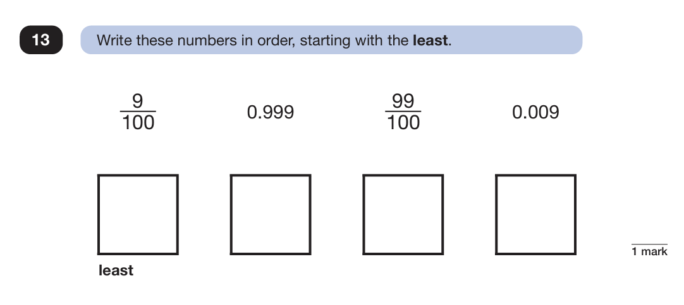
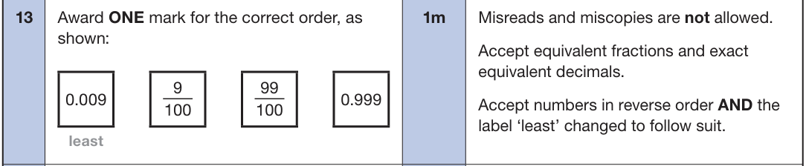
Maths Paper 3 (Reasoning)
Example questions:

Slide 23


Maths Paper 3 (Reasoning)
Example question:

Slide 24
Common Errors
Missing out the correct unit of measurement in the answer
General presentation – final answer not being clear
Numbers not clearly formed e.g. ‘0’ looking like a ‘6’
Decimal points – missing them out or making them look like a comma
2-step problems – make sure children follow the whole question through
Recording the monetary values incorrectly e.g. must be £8.90 not £8.9

Slide 25
During SATs week, we will be running our SATs
breakfast for the children.
Year 6 are invited to come into school at 8am
each day and have breakfast with their friends in the classroom.
We find that this usually helps to create a calm
atmosphere and helps to avoid children
becoming worried about sitting the tests.

Slide 26
Past Test Papers
•All of the past SATs tests are available online.
•If you’d like to have a look, or use any to practise, the best place to find them is at https://www.satspapers.org/.
•Although tests as far back as 2003 can be found on this website, only those from 2016 onwards are based on the new (and current) National Curriculum.
The links below take you to the appropriate pages:
http://www.satspapers.org/ks2maths2016onwards.htm
http://www.satspapers.org/KS2englishreading2016onwards.htm
http://www.satspapers.org/ks2english2016onwards.htm

